Slide 1

License Plate Detection using YOLO v8

Slide 2
Introduction
License Plate Detection using YOLO (You Only Look Once) refers to the application of the YOLO object detection algorithm to locate license plates within images or video frames. YOLO is a state-of-the-art deep learning model known for its efficiency and accuracy in real-time object detection tasks. In this context, the algorithm is trained on a dataset of license plate images to learn the features and patterns characteristic of license plates. Once trained, YOLO can swiftly analyze images or video streams and identify the presence and location of license plates, making it valuable for various applications such as vehicle tracking, surveillance, and automated toll collection.

Slide 3
Preprocessing:
License Plate Detection using YOLO
Data Cleaning
Remove any irrelevant or noisy data.
Handle missing values appropriately.
Image Resizing
Resize images to a consistent size to ensure compatibility with the deep learning model.
Data Augmentation
Increase the size of the training dataset by applying transformations such as rotation, flipping, and zooming.
Normalization
Normalize the pixel values of the images to a standardized range.
Feature Extraction
Extract relevant features from the images using techniques such as deep feature extraction or pre-trained models.

Slide 4
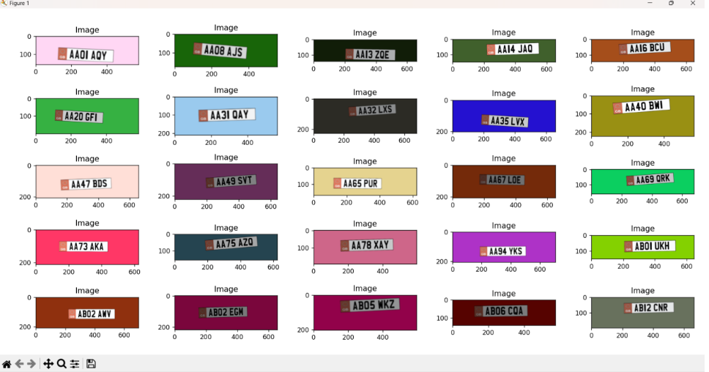
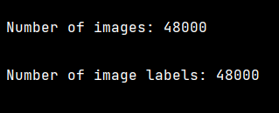
Preprocessing Output:
Final Obtained Accuracy : 0.9747916769981384

Slide 5
Binary Classification
It is a type of supervised learning where the goal is to classify data into two categories. It is commonly used in age, gender, and emotion classification using deep learning techniques.

Slide 6
Sequential Model
The sequential model is a type of deep learning architecture used for age, gender, and emotion classification. It consists of a linear stack of layers, where the output of one layer serves as the input for the next layer. This sequential structure allows for the efficient processing of sequential data, such as images or text.

Slide 7
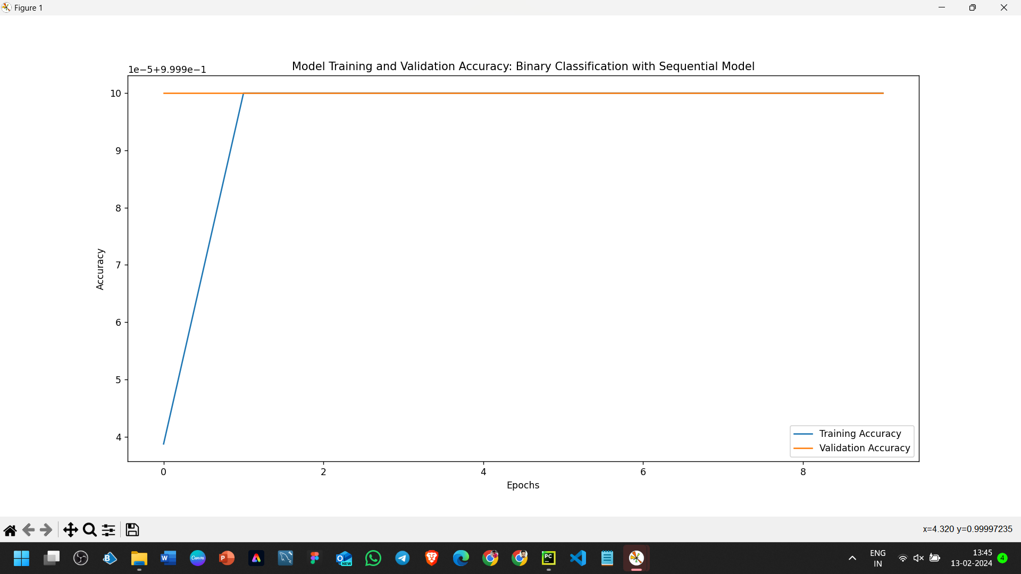
Binary classification outputs:

Slide 8
Optimization Techniques:
Adam
Adam is an adaptive learning rate optimization algorithm that is well-suited for training deep neural networks. It combines the benefits of two other popular optimizers, namely AdaGrad and RMSProp, to provide efficient and effective optimization
SGD
Stochastic Gradient Descent (SGD) is a widely used optimization algorithm for training deep learning models. It updates the model parameters based on the gradients of the loss function computed on a subset of the training data, known as a mini-batch.
RMSProp
RMSProp is an adaptive learning rate optimization algorithm that maintains a moving average of squared gradients to adjust the learning rate. It helps to prevent the learning rate from decaying too quickly and is particularly useful for training recurrent neural networks.

Slide 9
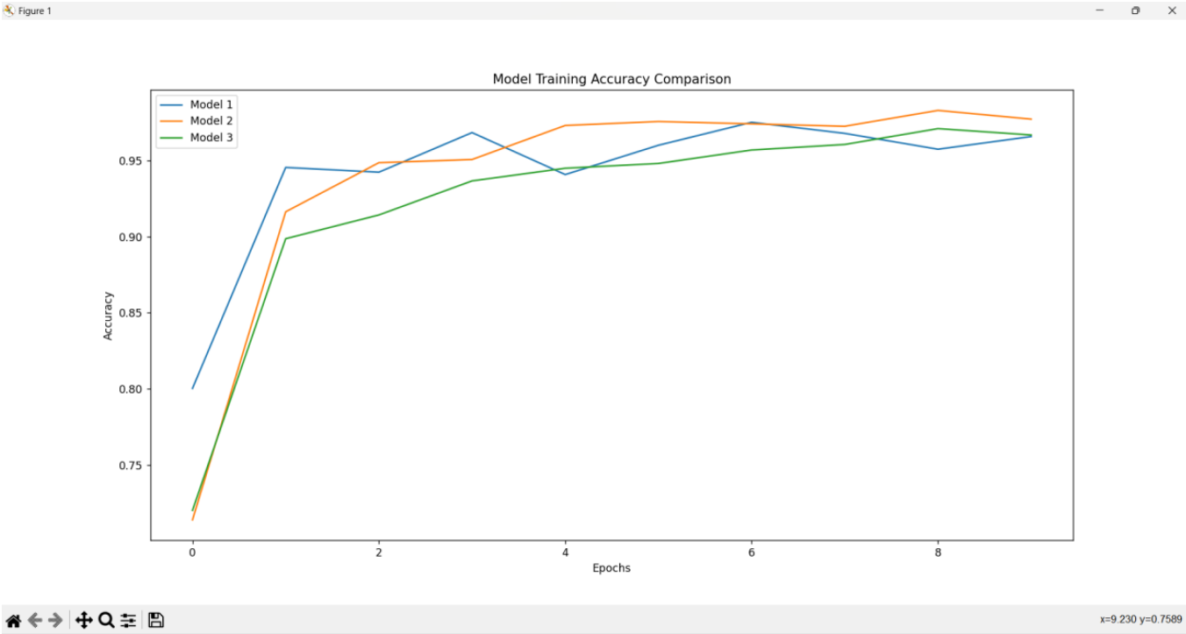
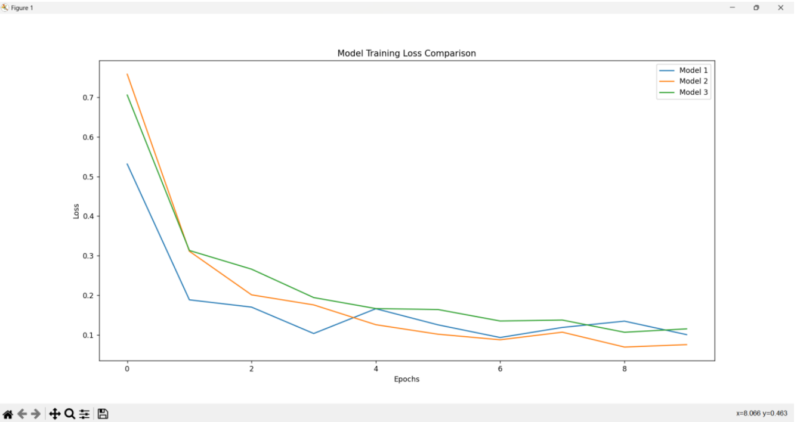
Optimizer Comparison Output:
Training Accuracy
Training Loss

Slide 10
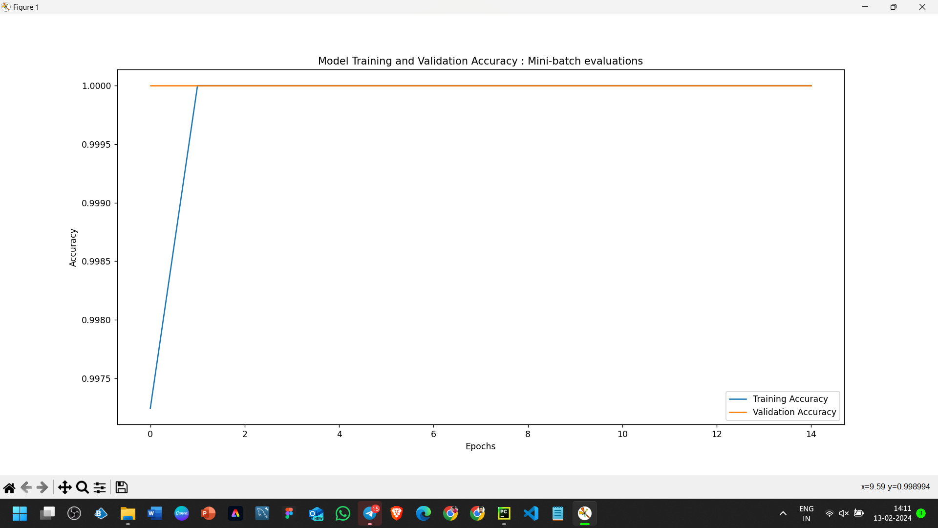
MINI BATCH Outputs:

Slide 11
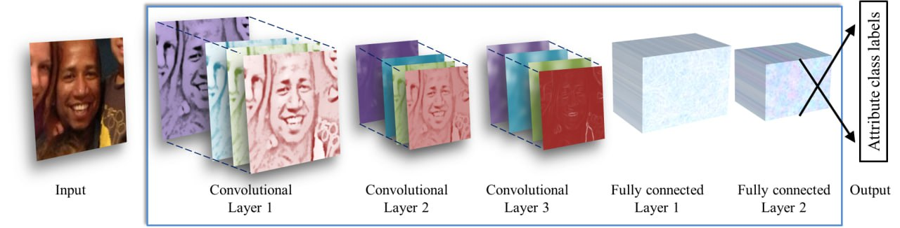
Convolutional Neural Networks (CNN)
The architecture of a CNN typically consists of multiple layers, including convolutional layers, pooling layers, and fully connected layers.
Convolutional layers apply filters to input images to extract important features. These filters capture patterns and spatial relationships in the Images.
Pooling layers reduce the spatial dimensions of the feature maps, reducing the computational complexity of the network while retaining important information.
Fully connected layers are responsible for the final classification. They take the output from the previous layers and map it to the desired number of classes.

Slide 12
Regularization
Preventing Overfitting
Regularization techniques are applied to the age, gender, and emotion classification models to prevent overfitting.
Overfitting occurs when a model performs well on the training data but poorly on new, unseen data.
L2 Regularization
This penalty discourages large weights, leading to a simpler and more generalizable model.
L2 regularization, also known as weight decay, adds a penalty term to the loss function.
Dropout
Dropout is a regularization technique that randomly sets a fraction of the input units to 0 during training.
This helps prevent the model from relying too heavily on any single feature and encourages the learning of more robust representations.

Slide 13
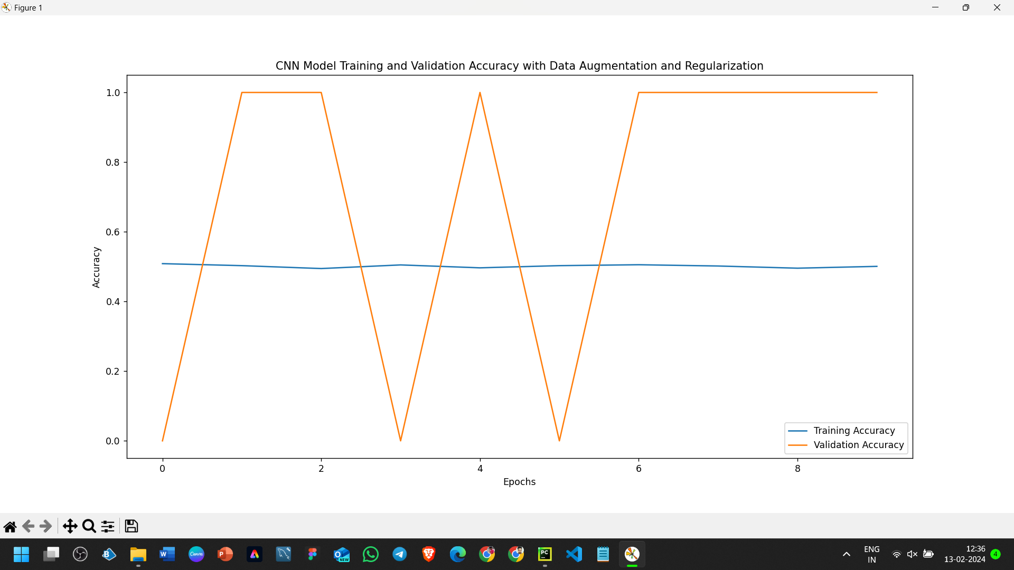
CNN Output:

Slide 14
VGG(visual Geometry Group):
The VGG model architecture is a deep learning model that has been widely used for age, gender, and emotion classification tasks. It is known for its simplicity and effectiveness in image classification.
The VGG model consists of multiple convolutional layers followed by fully connected layers. It uses small 3x3 filters with a stride of 1 and padding of 1, which helps to preserve spatial information and capture fine details in the images.
The model also incorporates max pooling layers to reduce the spatial dimensions and increase the receptive field of the network.
The VGG model has achieved high accuracy in various image classification tasks, making it a popular choice for age, gender, and emotion classification.

Slide 15
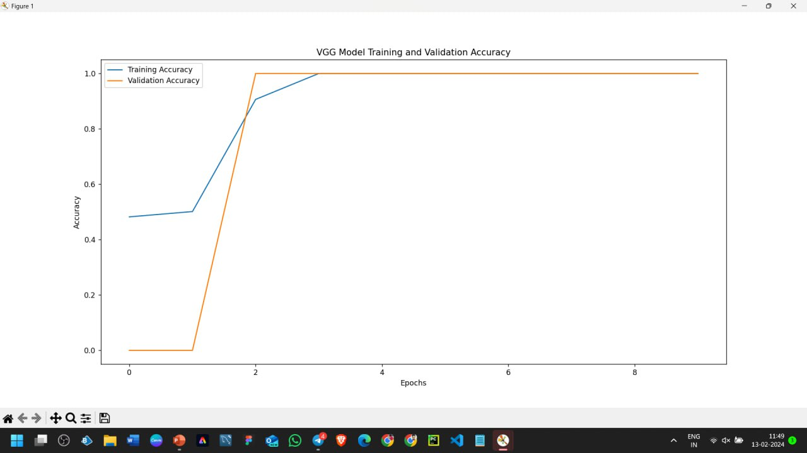
VGG Output:

Slide 16
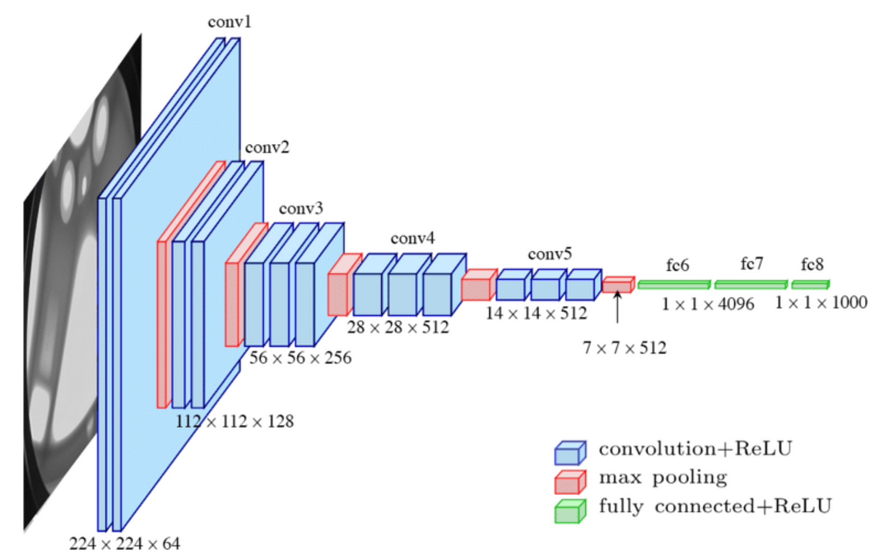
RNN (Recurrent Neural Network)
Recurrent Neural Networks, or RNNs for short, are a special kind of artificial neural network that excels at processing sequential data, such as text, speech, or even music. Unlike regular neural networks, which analyse each piece of data separately, RNNs can retain information from previous inputs, which makes them perfect for tasks like time series data recognition or sentence prediction.
general formula for a basic RNN cell: ht = f(Uxt + Wht-1 + b)
Types Of RNN:
Simple RNN Architecture Variations Based on Inputs and Outputs:
Different variations also exist depending on the number of inputs and outputs:
One-to-one
One-to-many
Many-to-one
Many-to-many
def cnn_transform_model(self,input_shape=(28,28,3),op="sgd"): cnn=Sequential() cnn.add(VGG16(weights="imagenet", include_top=False ,input_shape=(32,32,3))) cnn.add(Flatten()) cnn.add(Dense(1024,activation='relu', input_shape=[32, 32,3])) cnn.add(Dense(128, activation='relu')) cnn.add(Dense(64, activation='relu')) cnn.add(Dense(7, activation='softmax')) cnn.compile(loss="categorical_crossentropy", optimizer=op, metrics=['accuracy']) return cnn

Slide 17
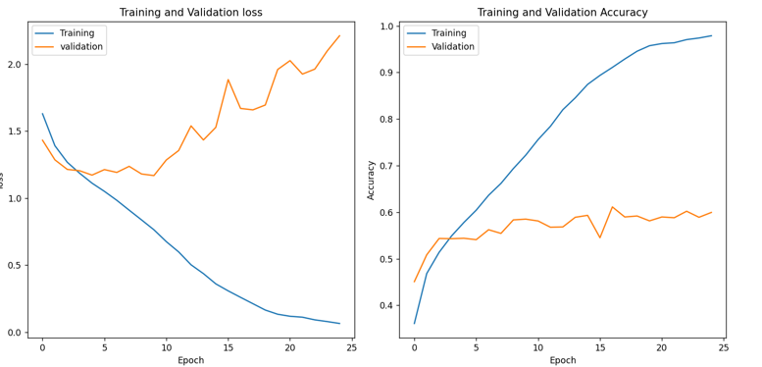
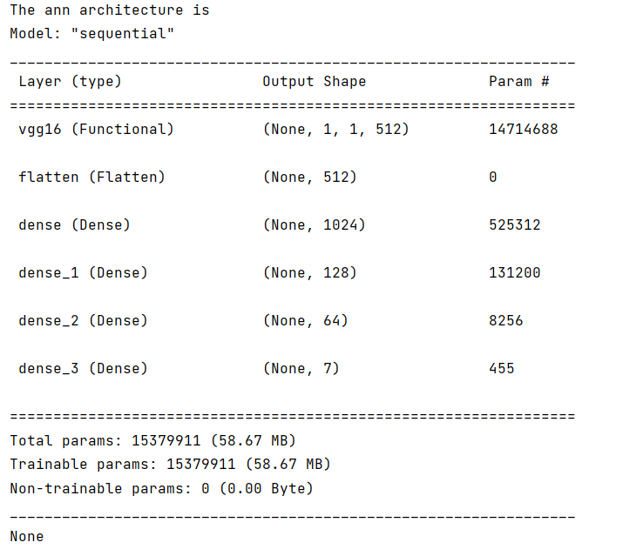
Output
Model.py
def create_rnn_model(self,input_shape,no_of_classes): model=Sequential() #reshape layer to flatten the input images 28,28,3 model.add(Reshape( ( input_shape[0] * input_shape[1],input_shape[2]),input_shape=input_shape) ) model.add(SimpleRNN(128)) model.add(Dense(64,activation='relu')) model.add(Dense(7,activation='softmax')) model.compile(optimizer='sgd', loss='categorical_crossentropy',metrics=['accuracy']) return model

Slide 18
CNN + LSTM
CNN+LSTM (Convolutional Neural Network + Long Short-Term Memory) is a powerful deep learning architecture that combines the strengths of CNNs and LSTMs to excel at tasks involving sequential data with spatial features.
Applications:
Image/Video Captioning
Activity Recognition
Sign Language Translation
Speech Recognition
Time Series Forecasting
Model.py
def create_LSTM_rnn_model(self, input_shape, no_of_classes): model = Sequential() # reshape layer to flatten the input images 28,28,3 model.add(Reshape((input_shape[0] * input_shape[1], input_shape[2]), input_shape=input_shape)) model.add(LSTM(128)) model.add(Dense(64, activation='relu')) model.add(Dense(7, activation='softmax')) model.compile(optimizer='sgd', loss='categorical_crossentropy', metrics=['accuracy']) return model

Slide 19
AUTOENCODER
Model.py
# Define autoencoder architecture input_img = Input(shape=(48, 48, 3)) x = Conv2D(32, (3, 3), activation='relu', padding='same')(input_img) x = MaxPooling2D((2, 2), padding='same')(x) x = Conv2D(16, (3, 3), activation='relu', padding='same')(x) encoded = MaxPooling2D((2, 2), padding='same')(x) x = Conv2D(16, (3, 3), activation='relu', padding='same')(encoded) x = UpSampling2D((2, 2))(x) x = Conv2D(32, (3, 3), activation='relu', padding='same')(x) x = UpSampling2D((2, 2))(x) decoded = Conv2D(3, (3, 3), activation='sigmoid', padding='same')(x) # Create autoencoder model autoencoder = Model(input_img, decoded) autoencoder.compile(optimizer='adam', loss='binary_crossentropy') return autoencoder, train_generator,test_generator
An autoencoder is a type of artificial neural network designed to learn efficient representations of data. It operates in an unsupervised learning manner, meaning it doesn't require labeled data for training. Here's a breakdown of how it works:
Encoding: The input data is passed through an encoder part of the network. This encoder compresses the data into a lower-dimensional representation, often called the latent space or encoding. This latent space captures the essential features of the data.
Decoding: The latent space representation is then fed into a decoder part of the network. The decoder's role is to reconstruct the original input data from the compressed representation.
Training: The autoencoder is trained to minimize the difference between the original input data and the reconstructed output data. This forces the encoder to learn a good representation of the data that allows for accurate reconstruction.
Applications:
Dimensionality Reduction
Feature Extraction
Data Denoising

Slide 20
DENOISE AUTOENCODER (DAE)
A denoising autoencoder (DAE) is a type of artificial neural network trained to reconstruct clean, original data from its corrupted or noisy version. It achieves this through an unsupervised learning process, meaning it doesn't require labeled data. DAEs consist of two main parts:
Encoder: Compresses the input data (often images, audio, or text) into a lower-dimensional latent representation, capturing essential features. This encoding process forces the DAE to learn robust, noise-resistant representations.
Decoder: Expands the latent representation back to the original data space, ideally reconstructing the clean input without the noise. By minimizing the difference between the reconstructed and original data, the DAE learns to remove noise while preserving the underlying structure.
Applications:
Image Denoising
Signal Denoising
Feature Learning

Slide 21
Thank You

